Slide 1
Database Design and Development (it 2140)
Lecture 01- Introduction to dbms, database design process and Data-Intensive Applications

Slide 2
Lecture content
Define key database-related terminologies
Introduction to databases, DBMS and their benefits
Database design process
Data-intensive applications

Slide 3
Learning outcomes
Explain what is a database and a DBMS.
Identify situations where using a database would be beneficial.
Explain the database design process.
Identify the importance of DBMSs in data-intensive applications.

Slide 4
What is Data vs Information?
Data refers to raw, unprocessed facts or values that, on their own, may not carry meaning. It can be in the form of numbers, text, images, or symbols.
Information is data that has been processed, organized, or structured in a way that makes it meaningful and useful.

Slide 5
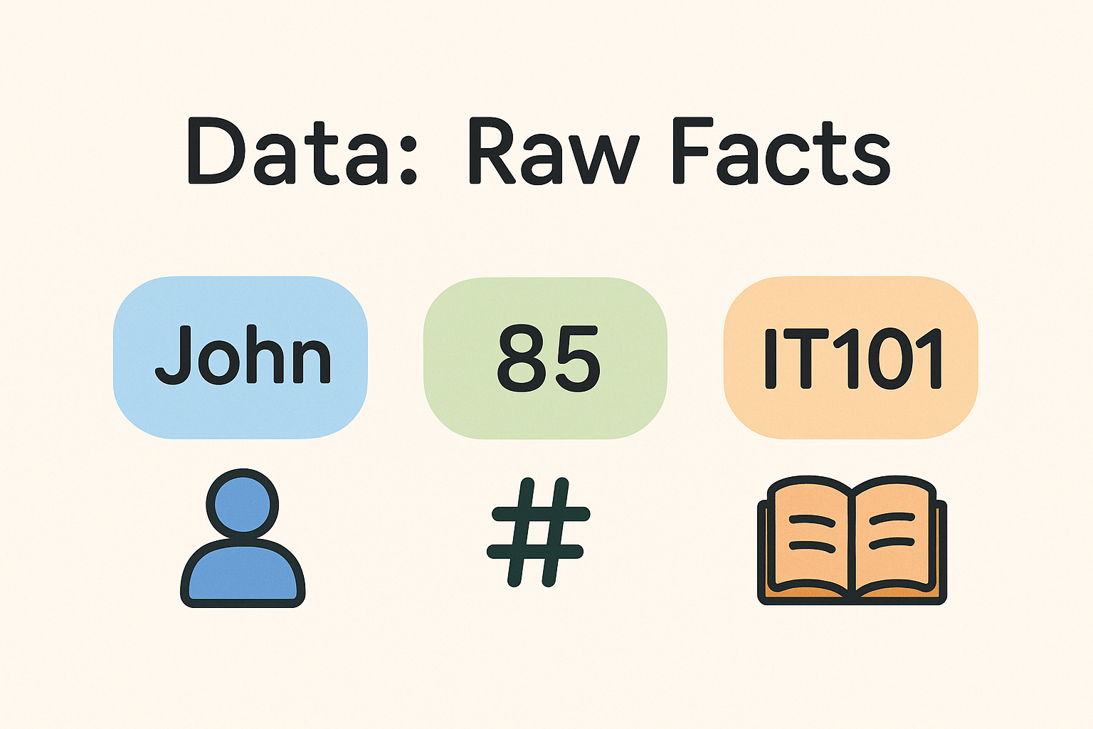
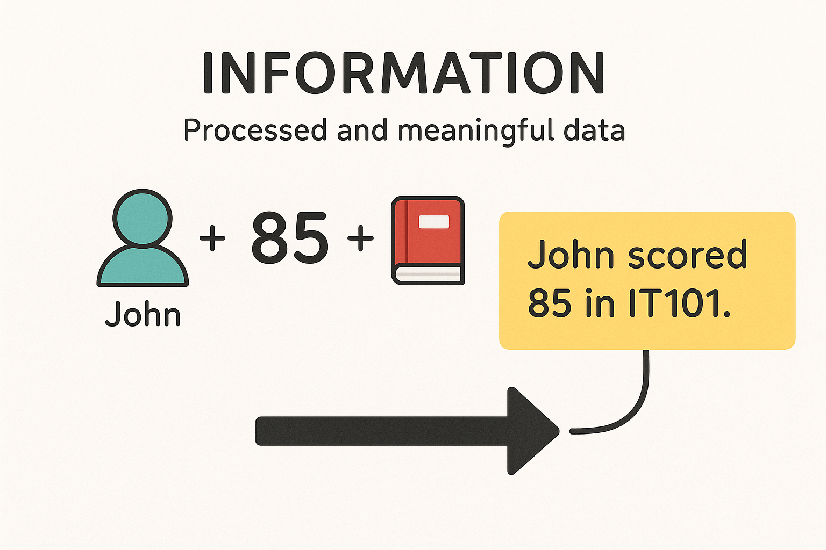
What is Data vs Information?

Slide 6
What is a database & a dbms?
A database is a collection of related data.
A database management systems (DBMS) is a general-purpose software system that facilitates the processes of defining, constructing, manipulating, and sharing databases among various users and applications.
What do you understand by defining, constructing, manipulating and sharing databases?

Slide 7
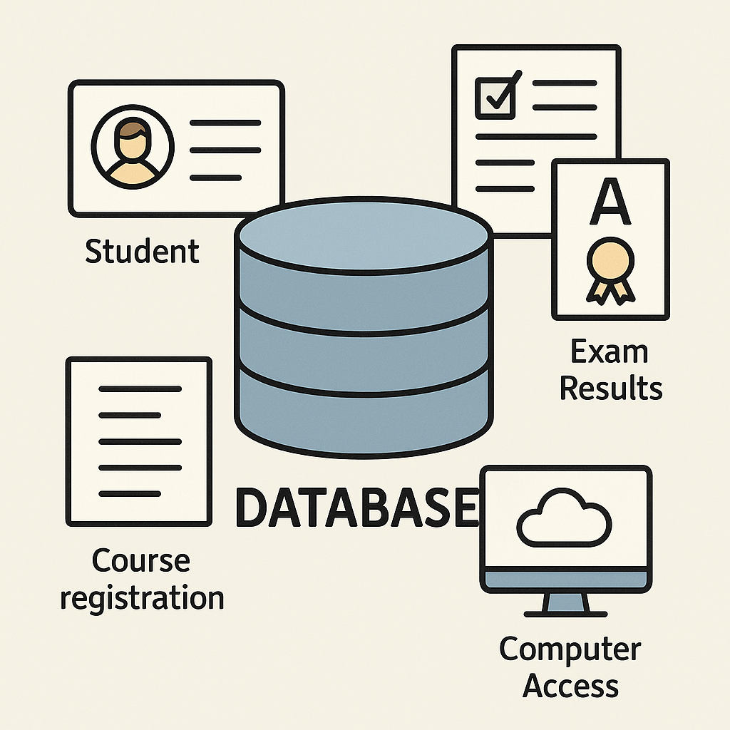
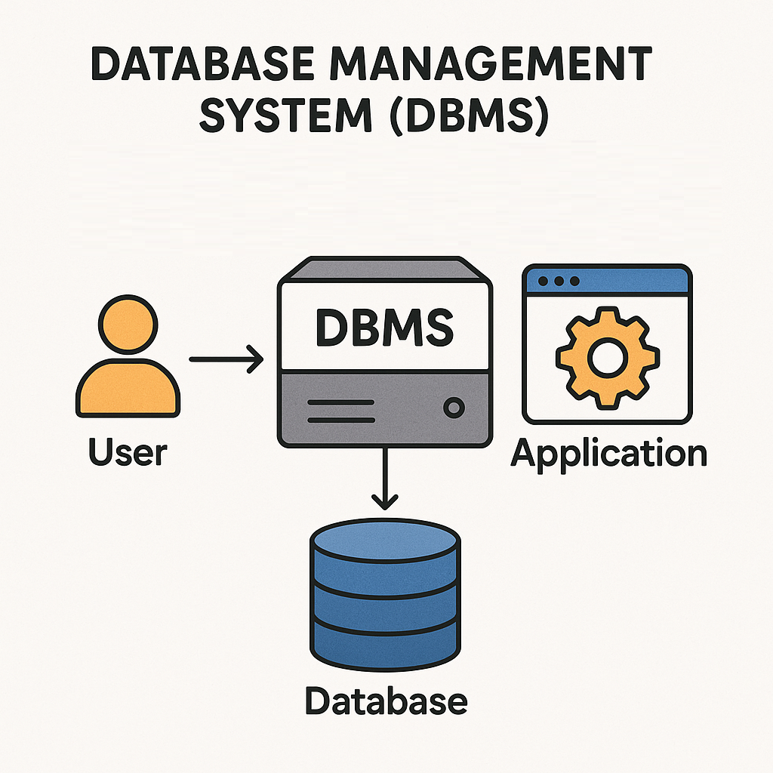
What is a database & a dbms?

Slide 8
❓ Question for Students
Can you identify one real-world place or system where databases are used? For each example,
Explain:
What kind of data is stored ?
Who uses the data ?
Why a database is necessary in that context?

Slide 9
Database System Environment
Database system environment normally can be considered to have five major parts.
Hardware
Software
People
Procedures
Data

Slide 10
Database approach vs file processing system
Database system is of self-describing nature
Database enables insulation between programs and data, and data abstraction
Databases support of multiple views of the data
Sharing of data and multiuser transaction processing
Security and access levels

Slide 11
Advantages of database approach
Data independence – application programs are independent of the way the data is structured and stored
Efficient data access – make the data retrieval efficient using sophisticated techniques to store and access data
Enforcing integrity – provide capabilities to define and enforce constraints
Ex: Data type for a name should be string
Restricting unauthorized access – allows only authorized users to access data
Providing backup and recovery – protects users from the effect of system failures
Concurrent access – simultaneous access of data by different users

Slide 12
Database design
Why is Database Design important?
Without careful planning you may create a database that…
contains unnecessary data which occupies the storage space
omits data required to create critical reports
takes a considerable time to respond to user questions
produces results that are incorrect or inconsistent
is unable to accommodate changes in the user's requirements
A poorly designed database will require more time in the long-term…!

Slide 13
Database design process
There are six main phases of the process to develop a database
Requirement collection and analysis
Conceptual database design
Logical database design
Schema refinement
Physical database design
Security design

Slide 14
Step 1: Requirement collection and analysis
The goals of the requirements analysis are:
to determine the data requirements of the database in terms of objects
to identify and describe the information about these objects
to identify the relationships among these objects
to identify different transactions that will be performed on the database
to identify performance, integrity, security or administrative constraints to be imposed on the database
to identify design and implementation constraints if any (ex: specific technologies, hardware and software, programming languages, policies, standards, etc…)

Slide 15
Step 1: Requirement collection and analysis
Information needed for the requirements analysis can be gathered in several ways:
Review of existing documents –
Can become familiar with the organization/ activity you need to model by reviewing the existing documentation. Ex: existing forms and reports, written guidelines, job descriptions, personal narratives, etc…
Interviews with end users –
Can organize individual/group meetings with the end users. Can use a blackboard, flip chart, or overhead transparencies to record information gathered from the interviews.
Review of existing automated systems –
Can review the system design specifications and documentation, if the organization already has an automated system

Slide 16
Step 2: Conceptual database design
The information gathered in the requirements analysis phase is used to create a:
high-level description of the data in a conceptual data model or Semantic Data Model.
Eg. ER Model

Slide 17
Step 3: Logical database design
In this step, we determine the DBMS to implement the database & also the data model.
We utilize the conceptual schema created in the previous step and convert it into a schema of a particular data model* (e.g. Relational Data Model )
*we will cover this in the next two lectures.

Slide 18
Step 4: Schema Refinement
The schema created by the logical database design phase is further refined for potential problems such as redundancies.

Slide 19
Step 5: Physical Database Design
In this step, performance criteria are taken into consideration and further enhancements to the schema & creation of indexes are considered.

Slide 20
Step 6: Security Design
Different user groups and their roles are identified.
Appropriate levels of access are then provided to the data ensuring that users have access to only the necessary data.
Eg. Bank
Customer – read access
Teller – read/update (limited)
Manager – read/update

Slide 21
Database Hosting
Database hosting defines where and how a database is deployed, stored, and accessed.
Selecting the appropriate hosting type depends on:
Scalability
Cost
Security
Performance

Slide 22
Types of Database Hosting
On-Premise Hosting
Cloud Hosting

Slide 23
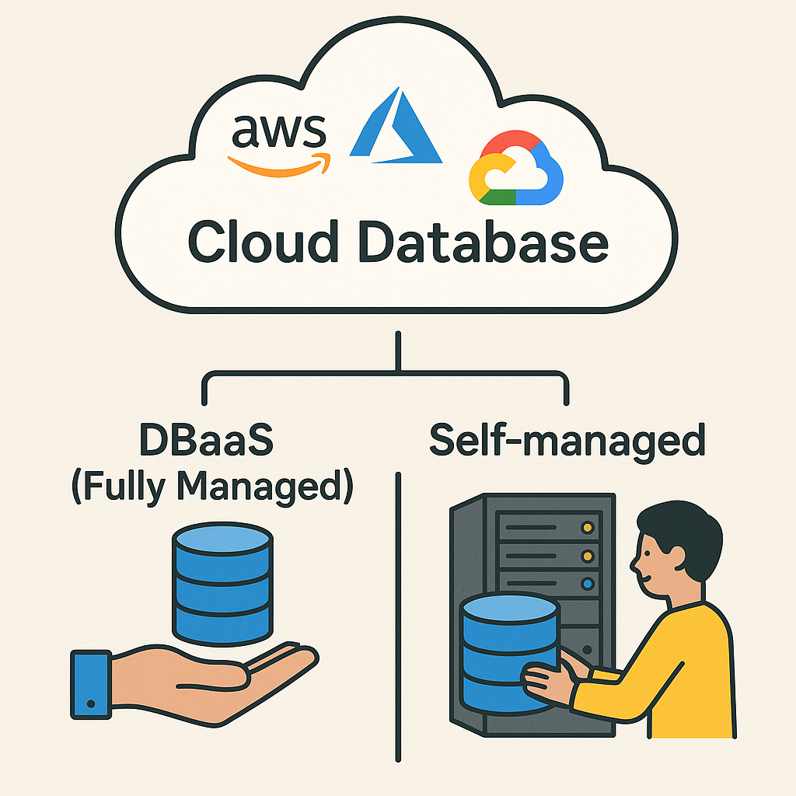
What is cloud Database?

Slide 24
Examples of cloud Database
Cloud Database | Examples
Relational Cloud Databases | AWS RDS, Azure SQL Database, Google Cloud SQL
NoSQL Cloud Databases | MongoDB Atlas, AWS DynamoDB, Google Firestore, Azure Cosmos DB

Slide 25
💭 Think–Pair–Share Activity
Cloud Databases – Advantages and Challenges

Slide 26
Data-intensive applications
What are Data-Intensive Applications?
Focus on handling large volumes of data rather than performing complex computations.
Involve extensive data storage, retrieval, and processing.
Require fast and consistent access to data.
Must be scalable to handle growing data and user loads.
Common in systems with real-time access and multiple concurrent users.
Depend heavily on reliable databases and DBMSs for performance and stability.

Slide 27
Examples of Data-Intensive Applications
Domain | Example Application | Types of Data Handled
Social Media | Facebook, Instagram | Posts, images, comments, likes, user profiles
E-Commerce | Amazon, eBay | Product listings, transactions, user carts, reviews
Banking | Online banking apps | Customer info, transactions, loan history, statements
Education | Learning Management Systems (LMS), like Moodle | Grades, courses, materials, attendance
Search Engines | Google, Bing | Crawled pages, user queries, ranking metadata

Slide 28
Why is a DBMS Critical for Data-Intensive Applications?
DBMS Feature | How It Helps
Data Storage & Retrieval | Efficient storage of huge volumes of structured data
Indexing | Fast lookups and search operations
Transactions & Concurrency | Handles simultaneous users and operations safely
Security & Access Control | Ensures authorized access to sensitive data
Backup & Recovery | Prevents data loss in case of failure
Query Optimization | Speeds up processing of complex queries
Scalability (esp. in Cloud) | Supports growth in data, users, and workloads dynamically

Slide 29
Homework question
Identify and describe five (5) modern technologies used in data-intensive applications.
For each technology, include:
The name of the technology
Its purpose or function
One real-world example where it is used

Slide 30
What you have to do by next week
Try out the self-test questions on the course web.
Try out tutorial and bring the answers to the class.

